Slide 1


Airline Ticket Booking System
This presentation introduces a web-based system designed to automate flight bookings for customers.
Users can search for flights, book tickets, and complete payments.
The system provides a user-friendly interface and an admin dashboard for managing operations.
by Yousef Badr

Slide 2
Team Members
Youssef Badry Abdelhamed
Kareem Mohamed Mohamed
User profiles and admin dashboard.
Flight search and booking system.

Slide 3
Introduction
Web-Based Platform
Admin Dashboard
Developed using ASP.NET MVC framework.
Centralized management system.
Automated flight bookings.
User management and control.
User-friendly interface.
Flight scheduling and updates.
Secure payment processing.
Booking monitoring and tracking.

Slide 4
Technologies Used
ASP.NET Core MVC
Entity Framework Core
Microsoft SQL Server
Web application framework.
Object-relational mapper.
Relational database management system.
Bootstrap, HTML, CSS, and JavaScript
LINQ and Lambda Expressions
Front-end development technologies.
Querying and data manipulation.

Slide 5
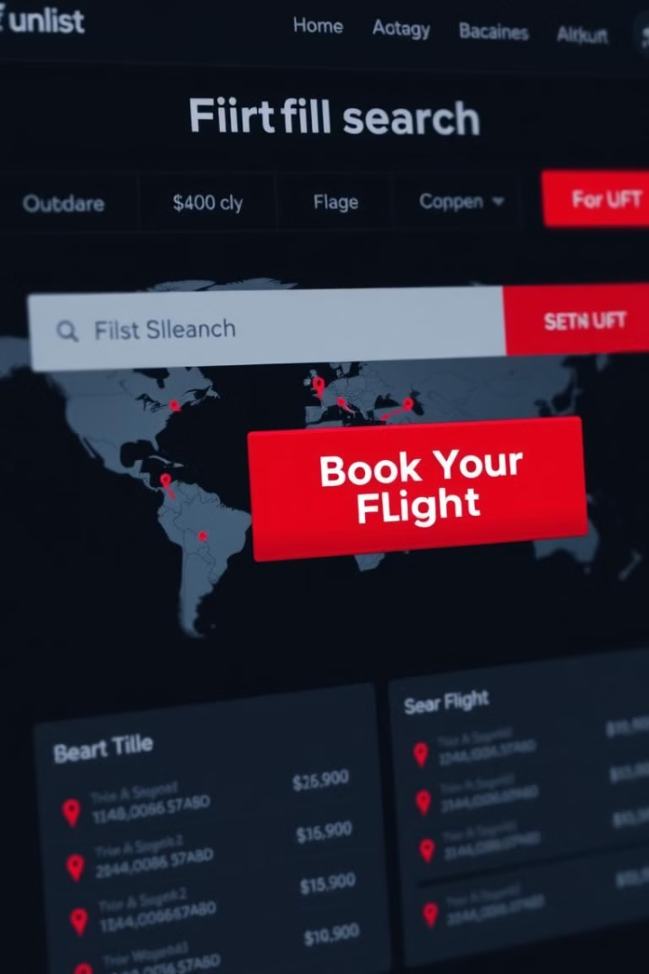
Main Features
1
User Accounts
Registration, login, and profile management.
2
Flight Search and Booking
Find flights, select seats, and make reservations.
3
Secure Payment Processing
Convenient and secure payment options.
4
Admin Dashboard
Manage users, flights, and bookings efficiently.

Slide 6
Youssef's Contributions
User Profile & Account Management
Admin Dashboard
Website Layout & Design
Designed and implemented the admin interface.
Created the website's visual structure and user interface.
Developed registration, login, and user profile features.
User management and access control.
Responsive design for various devices.
User data management and privacy.
Flight data management and scheduling.
User-friendly navigation and interactions.

Slide 7
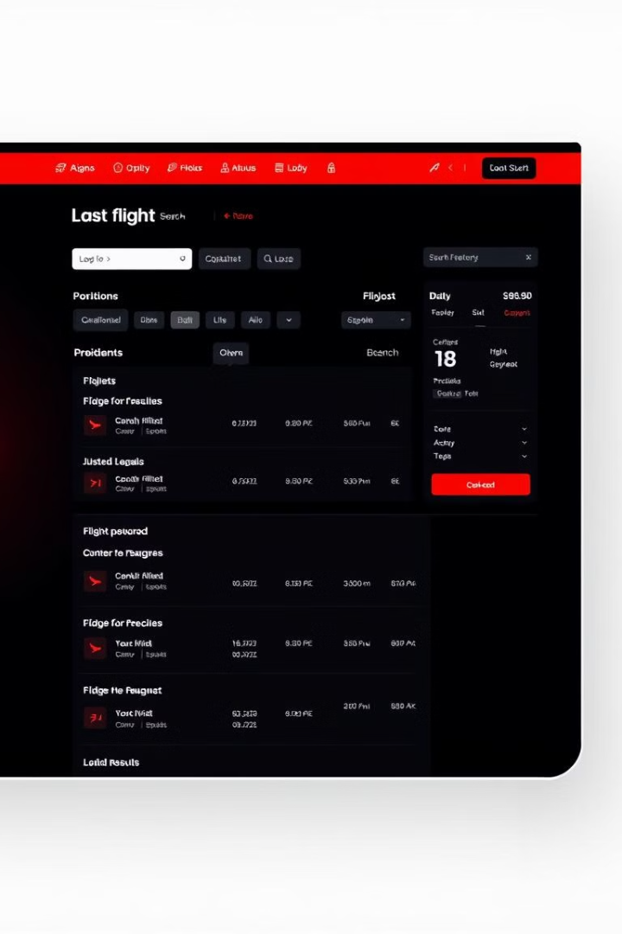
Kareem's Contributions
1
Search & Booking
User-friendly interface for finding flights.
2
Pricing & Payment
Integrated payment gateways and pricing models.
3
Confirmation & Management
Automated booking confirmation and management system.

Slide 8

Conclusion
1
2
3
Streamlined Booking
Enhanced User Experience
Efficient Management
Simplifies flight reservations.
Intuitive interface for easy use.
Tools for admin to control flights.

